Slide 1
Design and Analysis of Algorithms
Unit-2

Slide 2
Fibonacci Heap

Slide 3
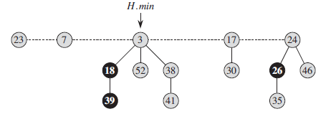
Fibonacci Heap
Definition
A Fibonacci heap is a collection of rooted trees that are min-heap ordered. That is, each tree obeys the min-heap property: the key of a node is greater than or equal to the key of its parent.
Example:

Slide 4
Representation of Fibonacci Heap
Circular doubly linked list is used to represent Fibonacci heap.
Each node x in binomial heap consists of following fields:-
x.p → pointer points to parent of x
x.child → pointer points to any child of x
x.left → pointer points to left sibling of x
x.right → pointer points to right sibling of x
x.key → value stored at node x
x.degree→ number of children of node x
x.mark → The boolean-valued attribute indicates whether node x has lost a child since the last time x was made the child of another node.
Fibonacci heap H has two fields:- H.min and H.n .
H.min → pointer points to the root of a tree containing the minimum key;
H.n → the number of nodes currently in H

Slide 5
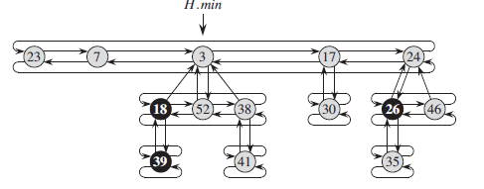
Representation of Fibonacci Heap
.

Slide 6
Potential Function
To analyze the performance of Fibonacci heap, we use the potential function.
We then define the potential Φ(H) of Fibonacci heap H by
Φ(H) = t(H) + 2m(H)
Where, t(H) is the number of tree in H and m(H) is the number of marked nodes.
Example: Consider the Fibonacci heap of previous slide.
Here, t(H) = 5 and m(H) = 3. Therefore
Φ(H) = 5 + 2*3 = 11
Maximum degree
Maximum degree of any n-node Fibonacci is denoted by D(n).
D(n) ≤ ⌊log n⌋

Slide 7
Amortized Cost
Amortized cost is computed for an operation. It is defined as following:-
Amortized cost = Actual cost + change in potential function due to operation

Slide 8
Mergeable-heap operations
Inserting a node
Finding the minimum node
Uniting two Fibonacci heaps
Extracting the minimum node
Decreasing a key
Deleting a node

Slide 9
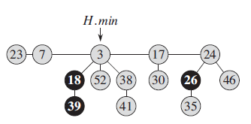
Inserting a node
Example: Insert a node with key 21 in the following Fibonacci heap.

Slide 10
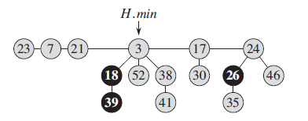
Inserting a node
Solution: Fibonacci heap after inserting element 21 in the Fibonacci heap.

Slide 11
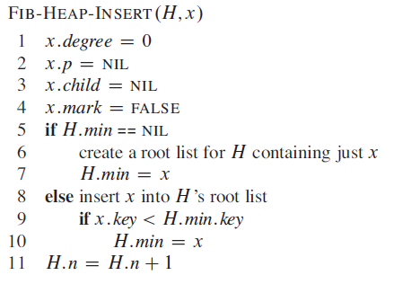
Inserting a node
The following procedure inserts node x into Fibonacci heap H, assuming that the node has already been allocated and that x:key has already been filled in.

Slide 12
Inserting a node
To determine the amortized cost of FIB-HEAP-INSERT, let H be the input Fibonacci heap and H’ be the resulting Fibonacci heap. Then,
t(H’) = t(H) + 1
and
m(H’) = m(H),
and the increase in potential = Φ(H’) - Φ(H)
= t(H’) + 2m(H’) – (t(H) + 2m(H) )
= t(H) + 1 + 2m(H) – (t(H) + 2m(H) )
= 1
The actual cost = O(1), therefore
Amortized cost = Actual cost + Φ(H’) - Φ(H)
= O(1) + 1 = O(1)

Slide 13
Finding the minimum node
The minimum node of a Fibonacci heap H is given by the pointer H.min, so we can find the minimum node in O(1) actual time. Because the potential of H does not change, therefore the amortized cost of this operation is equal to its O(1) actual cost.

Slide 14
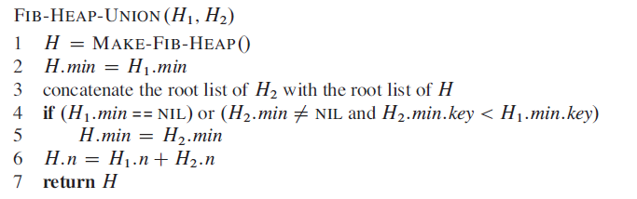
Uniting two Fibonacci heaps
The following procedure unites Fibonacci heaps H1 and H2, destroying H1 andH2 in the process. It simply concatenates the root lists of H1 and H2 and then determines the new minimum node. Afterward, the objects representing H1 and H2 will never be used again.

Slide 15
Uniting two Fibonacci heaps
Amortied cost:
The change in potential function
Φ(H) – (Φ(H₁) + Φ(H₂))
= t(H) + 2m(H) –(t(H₁) + 2m(H₁) + t(H₂) + 2m(H₂) )
= 0
Because t(H) = t(H₁) + t(H₂) and m(H) = m(H₁) + m(H₂)
Therefore the amortized cost
= actual cost + change in potential
= O(1) + 0
= O(1)

Slide 16
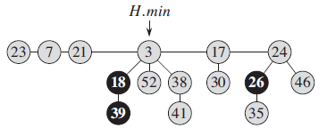
Extracting the minimum node
Example: Extract the minimum node from the following Fibonacci heap.

Slide 17
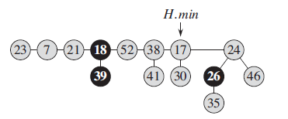
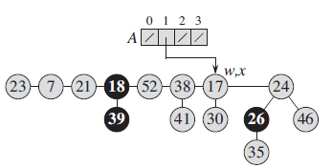
Extracting the minimum node
Solution:
Step-1:
Step-2:

Slide 18
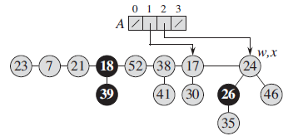
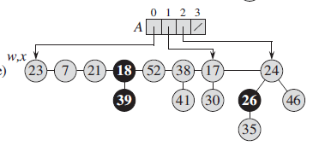
Extracting the minimum node
Step-3:
Step-4:

Slide 19
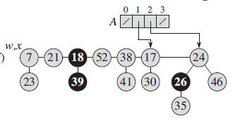
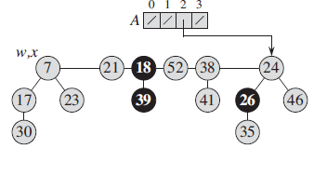
Extracting the minimum node
Step-5:
Step-6:

Slide 20
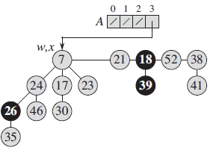
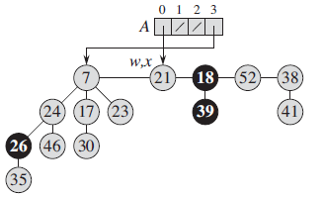
Extracting the minimum node
Step-7:
Step-8:

Slide 21
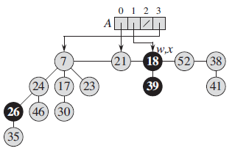
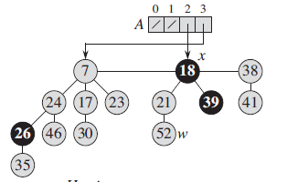
Extracting the minimum node
Step-9:
Step-10:

Slide 22
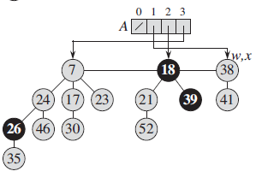
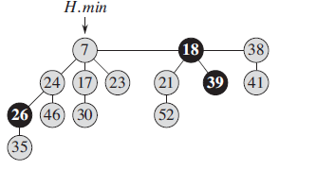
Extracting the minimum node
Step-11:
Step-12:
Final Fibonacci Heap

Slide 23
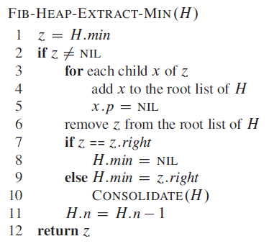
Extracting the minimum node

Slide 24
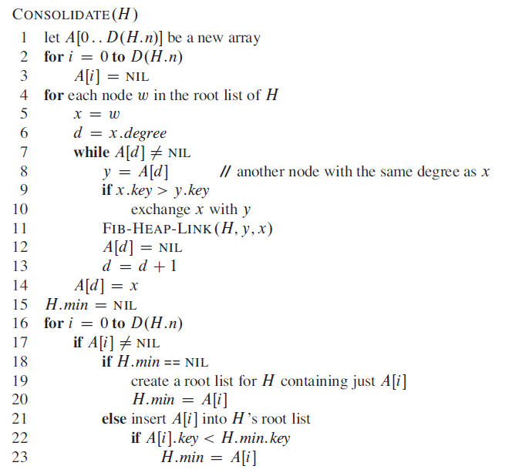
Extracting the minimum node

Slide 25
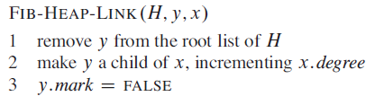
Extracting the minimum node
Computation of Amortized cost:
Let H denote the Fibonacci heap just prior to the FIB-HEAP-EXTRACT-MIN operation. Let n is the number of nodes in Fibonacci heap H. Let H’ is the Fibonacci heap after this operation. Therefore,
Actual cost = O(t(H)-1 + D(n)) = O(D(n) + t(H))
Now, t(H’) = D(n) and m(H’) = m(H)
Therefore, amortized cost = actual cost + change in potential
= O(D(n) + t(H)) + (Φ(H’) - Φ(H) )
= O(D(n) + t(H)) + (D(n) + 2m(H) – t(H) -2m(H))
= O(D(n) + t(H) + D(n) – t(H))
= O(D(n)) = O(log n))

Slide 26
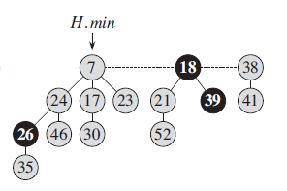
Decreasing a key
Example: Consider following Fibonacci heap.
Decrease the node with key 46 to key value 15.
After this, decrease node with key 35 to key value 5.

Slide 27
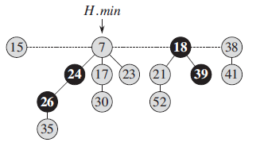
Decreasing a key
Solution:
Decrease the node with key 46 to key value 15.

Slide 28
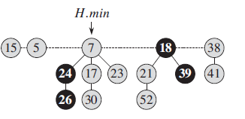
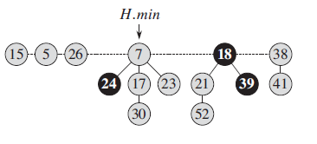
Decreasing a key
Decrease the node with key 35 to key value 5.
Step-1:
Step-2:

Slide 29
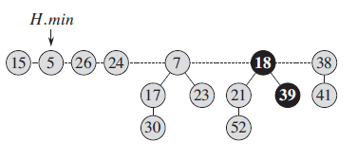
Decreasing a key
Step-3:
Final Fibonacci heap

Slide 30
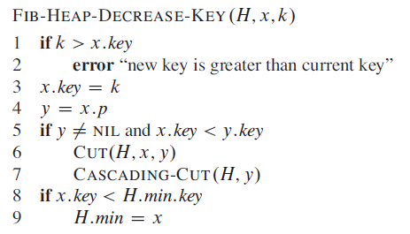
Decreasing a key

Slide 31
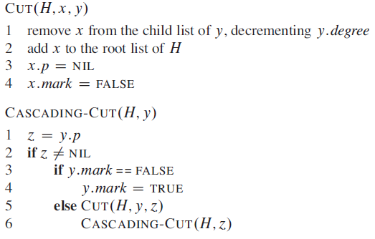
Decreasing a key

Slide 32
Decreasing a key
Amortized cost:
Suppose the cascading cut function is called c times.
Therefore, the actual cost of FIB-HEAP-DECREASE-KEY is O(c).
Now, Let H is the initial Fibonacci heap and H’ is the Fibonacci heap after this operation. Therefore,
t(H’) = t(H) + c
(the original t(H) trees, c-1 trees produced by cascading cuts, and the tree rooted at x)
Maximum number of marked nodes,
m(H’) = m(H) – c + 2
(c -1 were unmarked by cascading cuts and the last call of CASCADING-CUT may have marked a node)
Therefore, amortized cost = O(c) + ((t(H’) + 2m(H’)) –( t(H) + 2m(H)))
= O(c) + (t(H) + c + 2(m(H) – c + 2 ) – ( t(H) + 2m(H)))
= O(c) – c + 4 = O(4) = O(1)

Slide 33
Thank You.

